Slide 1
Bade Srinivasa Rao
Megha Jain
Muskan Mohan
Priyanka Mhetre
Rajat Kumar
Sahil Arora
Thushar K Nimbalkar
Group 10 CEP 16 Task 4:

Slide 2
Opportunity for Restructuring discount strategy
Consulting & CO.
E-Mandi - An ecommerce startup

Slide 3

01
Understanding the Industry
02
Observation - eMandi
Table of contents
03
Market & Competition
04
Business Model

Slide 4
01
Understanding the Industry

Slide 5
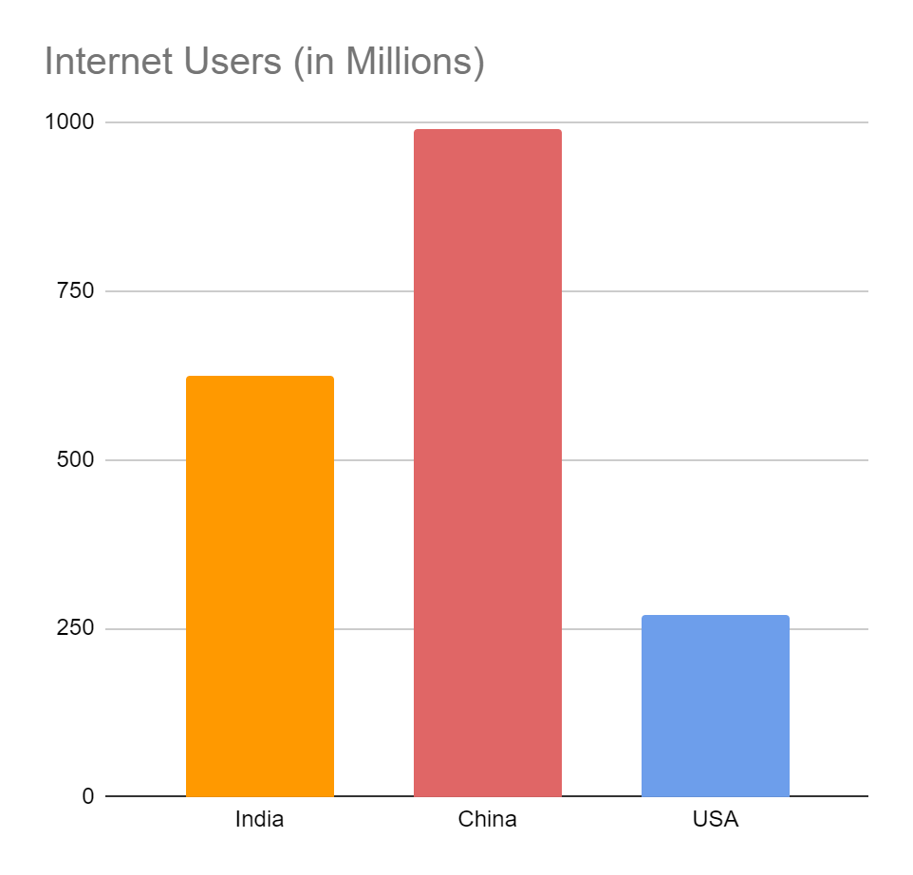
Consulting & CO.
The Indian E-commerce market is expected to grow from US$ 38.5 billion (2017) to US$ 200 billion by 2026.
The Indian online grocery market is estimated to reach US$ 18.2 billion in 2024 from US $1.9 billion in 2019.
Compound annual growth rate (CAGR 20-24)is expected to be 13%.
The ‘Digital India’ programme, has led significant increase in the number of internet user to 624.45 million in India.

Slide 6
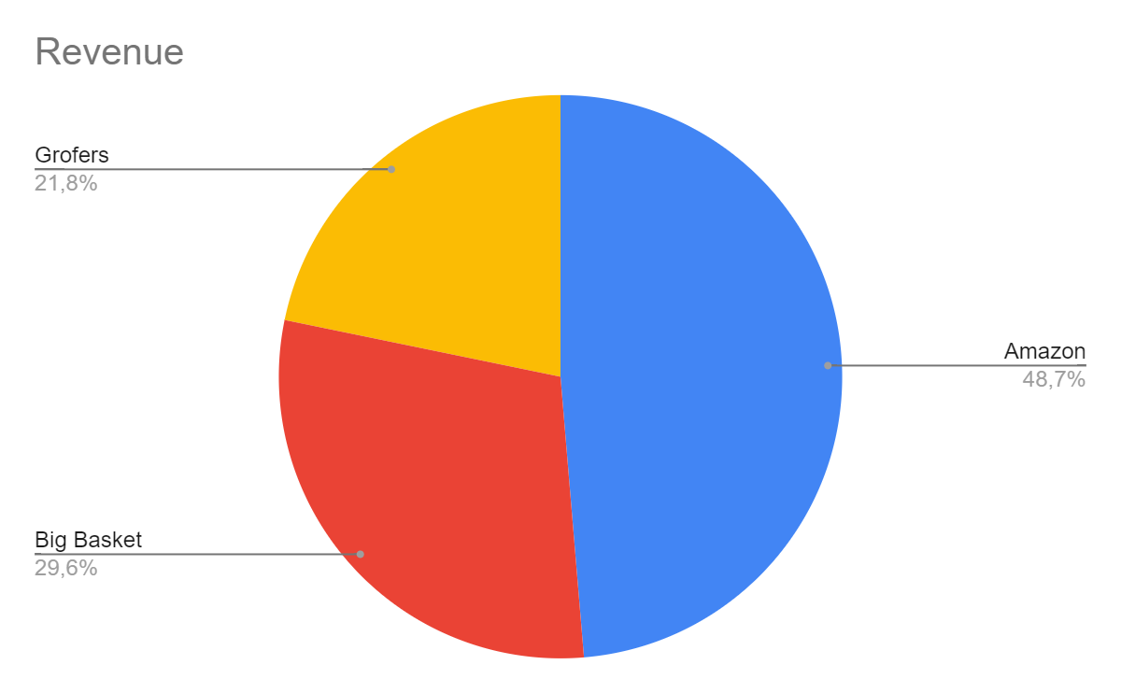
Top e-commerce performers in terms of Revenue
Consulting & CO.
48.7%
AMazon
Revenue - $1100 million
29.6%
Big Basket
Revenue - $668 million
21.8%
Grofers
Revenue - $492 million
To modify this graph, click on it, follow the link, change the data and paste the new graph here

Slide 7
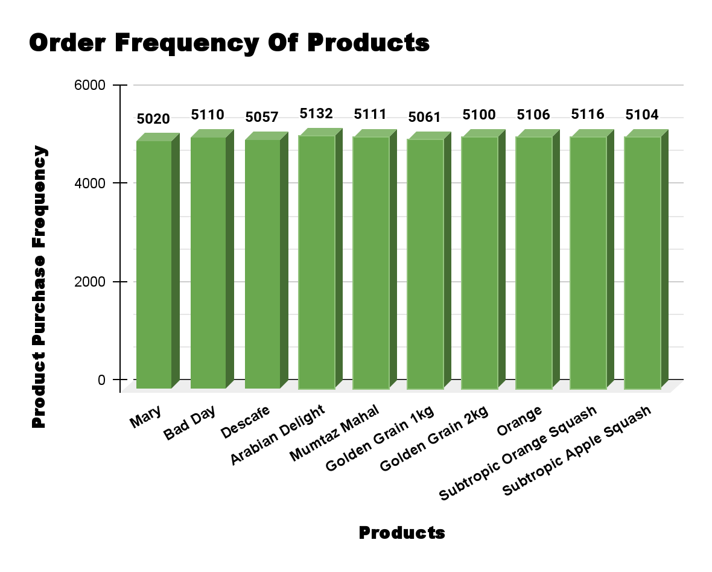
Product Sales frequency
Fruit Juice
Consulting & CO.
Highest - 10,220
Rice
Second highest - 10,161
Coffee
Lowest - 5057

Slide 8
02
OBSERVATIONS

Slide 9
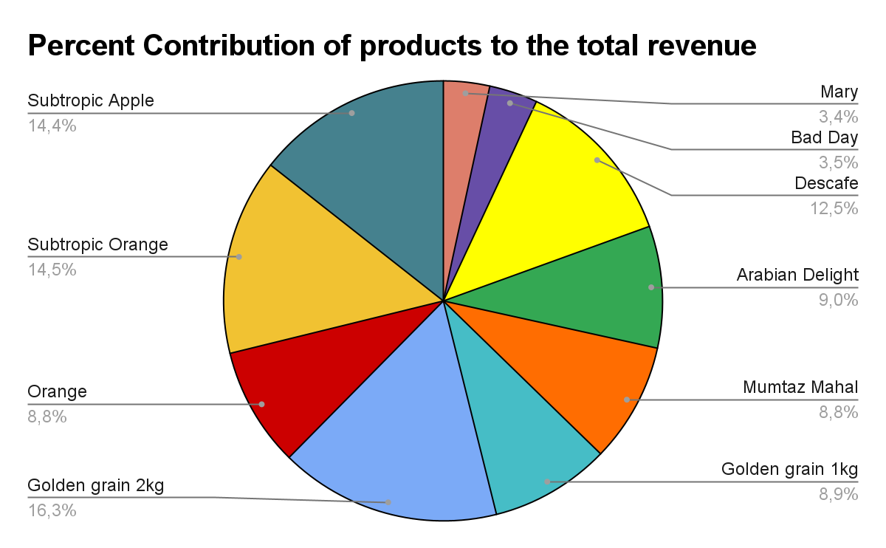
Observations - eMandi
Consulting & CO.
Subtropic Orange Squash has the highest order frequency, and the category Fruit Juices has most frequent purchases. The lowest bought product is Descafe of the Tea category.
The highest profit margin and total sales is achieved by the product Golden Grain 2kg and the product with lowest profit and sales is Mary from the biscuits category.
Looking at individual item sales, product Arabian Delight has the highest sales.

Slide 10
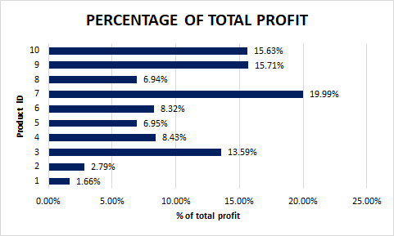
PRODUCT CONTRIBUTION TO
THE TOTAL PROFIT
Consulting & CO.

Slide 11
PRODUCT CONTRIBUTION TO THE TOTAL PROFIT
Consulting & CO.
OBSERVATION
SUGGESTION
The highest average profit is 19.99% of the total profit which is obtained for product which has ID number is 7 and the lowest average profit is 1.66% of the total profit which is for product ID number 1.
So, finally there are four main product IDs i.e. 3, 7, 9 and 10 which has more contribution to the total profit.
Therefore, it is important to focus on these product for improving our profit.
Also need to focus on low profit margin product by adding some innovative changes. So, customer can focus more on this product.

Slide 12
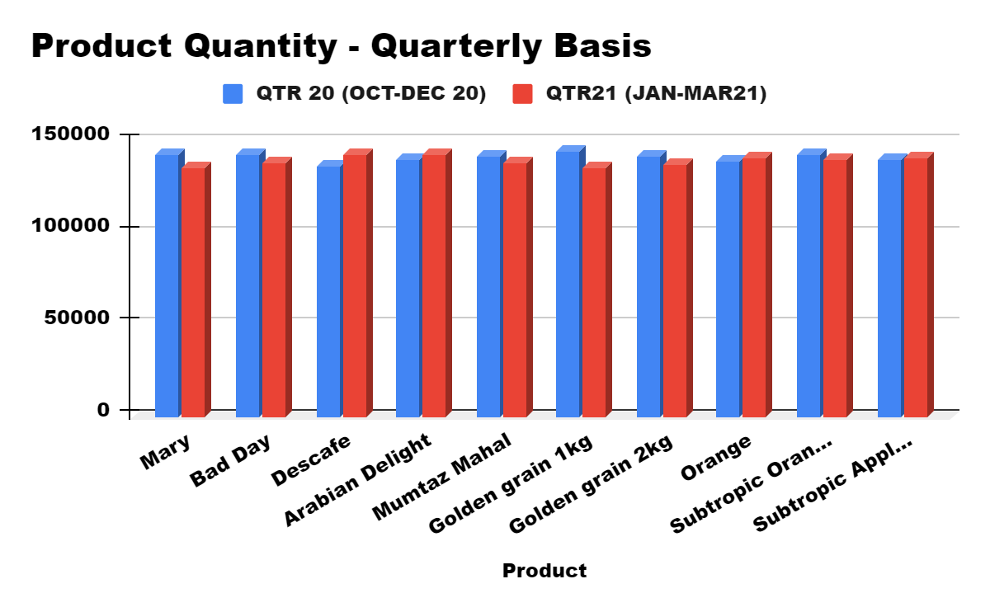
Quarterly Analysis
Consulting & CO.

Slide 13
Quarterly Analysis
Observing the quarterly sales in the years 2020 and 2021, sales during Q4 2020 had 2148 sales more than the during Q1 2021. The total revenue generated follows the same trends.
Observing on a monthly basis, the first month of both the quarterlies had more sales than the rest of the three months following it.
Product wise sum of total profit is highest for Golden Grain 2kg (with Product ID 7) for both Quarter 1 and Quarter 2. Product wise sum of total profit is lowest for Mary (with Product ID 1) for both Quarter 1 and Quarter 2.
Suggestions:
Discounts strategy should be implemented for the products that have Total profits less than Rs.85,000.
This will lead to increase in the sales for products like - Mary, Bad Day, Arabian Delight, Mumtaz Mahal, Golden Grain 1 kg, and Orange.

Slide 14
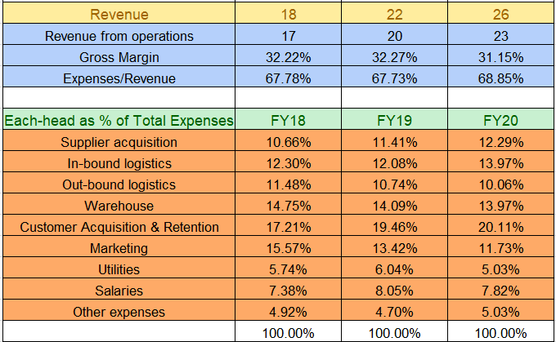
Financial Profit Contributions Of KPIs

Slide 15
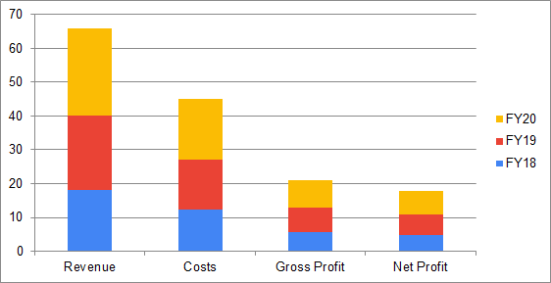
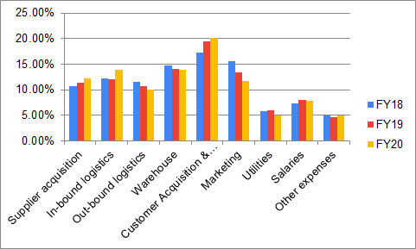
FORECAST AND KPIs
Consulting & CO.
Across all 4(in Crs), FY18 ranged from 4.90 to 18,FY19 ranged from 6 to 22, and FY20 ranged from 6.90 to 26,

Slide 16
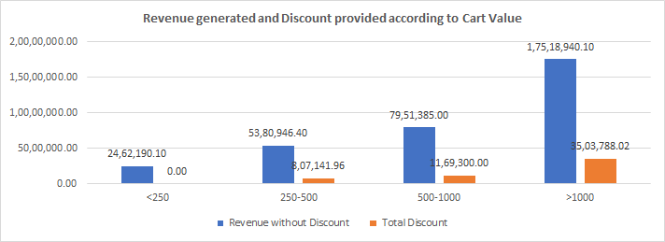
DISCOUNT STRATEGY
Consulting & CO.

Slide 17
DISCOUNT STRATEGY: OBSERVATION
Consulting & CO.
Maximum number of orders are received for the cart value less than Rs 250 which implies that order is made for small number of items (average of 6 items in a cart) and revenue/order is quite less.
Minimum number of orders are received for the cart value more than for Rs 1000, people are refraining from ordering carts with large number of items.
Even though orders with value less than Rs 250 are most in number, revenue generated from such orders is least and vice-versa and revenue gradually increases with increasing cart value.
Most of the revenue is lost for cart values of more than Rs 1000 (evident from ratios calculated in column O) followed by cart value of Rs. 250-500 and then cart value of Rs. 500-1000. Same trend can also be observed from ratio calculated in column Q, most discount is provided for cart value od Rs. >1000 and so on.
Observations:
1) Maximum number of orders are received for the cart value less than Rs 250 which implies that order is made for small number of items (average of 6 items in a cart) and revenue/order is quite less.
2) Minimum number of orders are received for the cart value more than for Rs 1000, people are refraining from ordering carts with large number of items.
3) Even though orders with value less than Rs 250 are most in number, revenue generated from such orders is least and vice-versa and revenue gradually increases with increasing cart value.
4) Most of the revenue is lost for cart values of more than Rs 1000 (evident from ratios calculated in column O ) followed by cart value of Rs. 250-500 and then cart value of Rs. 500-1000. Same trend can also be observed from ratio calculated in column Q, most discount is provided for cart value od Rs. >1000 and so on.

Slide 18
DISCOUNT STRATEGY: SUGGESTIONS
Consulting & CO.
Since most orders are of value less than Rs 250, it increases the logistics cost and frequent trips for lesser revenue/order (Average order value). We can use Bundling strategy or Market Basket Analysis to upsell and increase sales. For example, Biscuits can be bundled with either coffee or fruit juice since people consume them in breakfast.
We can also offer volume discounts to increase sales.
Since order of value more than Rs 1000 brings in most revenue we should shift our focus to this segment. The discount currently offered should be reduced and cap value should be lowered down because to avail discount of Rs 300 cart value should be Rs 1500 and above which is very less in number seen in data. Instead of giving discount on price we can offer free shipping and cashbacks which is again credited into their online account like Amazon Pay cashback.
Observations:
1) Maximum number of orders are received for the cart value less than Rs 250 which implies that order is made for small number of items (average of 6 items in a cart) and revenue/order is quite less.
2) Minimum number of orders are received for the cart value more than for Rs 1000, people are refraining from ordering carts with large number of items.
3) Even though orders with value less than Rs 250 are most in number, revenue generated from such orders is least and vice-versa and revenue gradually increases with increasing cart value.
4) Most of the revenue is lost for cart values of more than Rs 1000 (evident from ratios calculated in column O ) followed by cart value of Rs. 250-500 and then cart value of Rs. 500-1000. Same trend can also be observed from ratio calculated in column Q, most discount is provided for cart value od Rs. >1000 and so on.

Slide 19
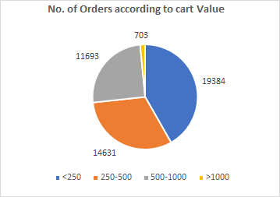
DISCOUNT STRATEGY: SUGGESTIONS
Consulting & CO.
Combo offers can be given on high priced items if we want to clear the inventory of low priced items. For example, biscuits with rice.
We can also use the historic data to create a database so that we can build recommendation engine to recommend customers according to their buying habits. Amazon generate 35% of its revenue from recommendation engine. Some companies use "Did you forget" method where person while adding item to cart is recommended if they've forgotten to add something on the basis of past purchases.
Observations:
1) Maximum number of orders are received for the cart value less than Rs 250 which implies that order is made for small number of items (average of 6 items in a cart) and revenue/order is quite less.
2) Minimum number of orders are received for the cart value more than for Rs 1000, people are refraining from ordering carts with large number of items.
3) Even though orders with value less than Rs 250 are most in number, revenue generated from such orders is least and vice-versa and revenue gradually increases with increasing cart value.
4) Most of the revenue is lost for cart values of more than Rs 1000 (evident from ratios calculated in column O ) followed by cart value of Rs. 250-500 and then cart value of Rs. 500-1000. Same trend can also be observed from ratio calculated in column Q, most discount is provided for cart value od Rs. >1000 and so on.

Slide 20
Thank You

